Slide 1
Graph Traversal
BFS (Breadth First Search)
  Start from a vertex, visit all the reachable vertices in a breadth first manner
  Uses Queue for non-recursive implementation
DFS (Depth First Search)
  Start from a vertex, visit all the reachable vertices in a depth first manner
  Uses Stack for non-recursive implementation

Slide 2
Depth-First Search
dfs (Node v)
[Push v on the stack STK]
push(STK,v);
Repeat steps 3 to 5 while STK is not empty
[Pop top element from STK]
  u=pop(STK);
If u is not in visited list
  Add u to the list of visited nodes
For each w adjacent to u
  If w is not visited then Push(STK,w);

Slide 3
Example
5
2
0
1
3
7
4
6

Slide 4
DFS: Start with Node 5
5
2
0
1
3
7
4
6

Slide 5
DFS: Start with Node 5
5
5
2
0
1
3
7
4
6
Push 5
Visited:{}

Slide 6
DFS: Start with Node 5
5
2
0
1
3
7
4
6
Pop/Visit 5
Visited: {5}

Slide 7
DFS: Start with Node 5
1
2
5
2
0
1
3
7
4
6
Push 2, Push 1
Visited: {5}

Slide 8
DFS: Start with Node 5
2
5
2
0
1
3
7
4
6
Pop/Visit 1
Visited: {5,1}

Slide 9
DFS: Start with Node 5
0
2
4
2
5
2
0
1
3
7
4
6
Push 4, Push 2, Push 0
Visited: {5,1}

Slide 10
DFS: Start with Node 5
2
4
2
5
2
0
1
3
7
4
6
Pop/Visit 0
Visited: {5,1,0}

Slide 11
DFS: Start with Node 5
3
7
2
4
2
5
2
0
1
3
7
4
6
Push 7, Push 3
Visited: {5,1,0}

Slide 12
DFS: Start with Node 5
7
2
4
2
5
2
0
1
3
7
4
6
Pop/Visit 3
Visited: {5,1,0,3}

Slide 13
DFS: Start with Node 5
2
7
2
4
2
5
2
0
1
3
7
4
6
Push 2
Visited: {5,1,0,3}

Slide 14
DFS: Start with Node 5
7
2
4
2
5
2
0
1
3
7
4
6
Pop/Visit 2
Visited: {5,1,0,3,2}

Slide 15
DFS: Start with Node 5
7
2
4
2
5
2
0
1
3
7
4
6
No push operation
Visited: {5,1,0,3,2}

Slide 16
DFS: Start with Node 5
2
4
2
5
2
0
1
3
7
4
6
Pop/Visit 7
Visited: {5,1,0,3,2,7}

Slide 17
DFS: Start with Node 5
6
2
4
2
5
2
0
1
3
7
4
6
Push 6
Visited: {5,1,0,3,2,7}

Slide 18
DFS: Start with Node 5
2
4
2
5
2
0
1
3
7
4
6
Pop/Visit 6
Visited: {5,1,0,3,2,7,6}

Slide 19
DFS: Start with Node 5
4
2
5
2
0
1
3
7
4
6
Pop (don’t visit) 2
Visited: {5,1,0,3,2,7,6}

Slide 20
DFS: Start with Node 5
2
5
2
0
1
3
7
4
6
Pop/Visit 4
Visited: {5,1,0,3,2,7,6,4}

Slide 21
DFS: Start with Node 5
5
2
0
1
3
7
4
6
Pop (don’t visit) 2
Visited: {5,1,0,3,2,7,6,4}

Slide 22
DFS: Start with Node 5
5
2
0
1
3
7
4
6
Done
Visited: {5,1,0,3,2,7,6,4}

Slide 23
Breadth-first Search
bfs (Node v)
[add v to QUEUE]
enqueue(QUEUE,v);
Repeat steps 3 to 5 while QUEUE is not empty
[Remove one element from QUEUE]
  u=dequeue(QUEUE);
If u is not in list of visited nodes then Add u to list of visited nodes
For each w adjacent to u
  If w is not visited then enqueue(QUEUE,w);

Slide 24
BFS: Start with Node 5
5
2
0
1
3
7
4
6
F=0
R=0
1 | 2 | 3 | 4 | 5 | 6 | 7 | 8 | 9 | 10

Slide 25
BFS: Start with Node 5
Visisted:
5
2
0
1
3
7
4
6
F=1
R=1
5
1 | 2 | 3 | 4 | 5 | 6 | 7 | 8 | 9 | 10
Enqueue 5

Slide 26
BFS: Start with Node 5
Visisted: 5
5
2
0
1
3
7
4
6
F=0
R=0
1 | 2 | 3 | 4 | 5 | 6 | 7 | 8 | 9 | 10
Dequeue/Visit 5

Slide 27
BFS: Start with Node 5
Visisted: 5
5
2
0
1
3
7
4
6
F=1
R=2
1 | 2
1 | 2 | 3 | 4 | 5 | 6 | 7 | 8 | 9 | 10
Enqueue 1, 2

Slide 28
BFS: Start with Node 5
Visisted: 5 1
5
2
0
1
3
7
4
6
F=2
R=2
 | 2
1 | 2 | 3 | 4 | 5 | 6 | 7 | 8 | 9 | 10
Dequeue/Visit 1

Slide 29
BFS: Start with Node 5
Visisted: 5 1
5
2
0
1
3
7
4
6
F=2
R=5
 | 2 | 0 | 2 | 4
1 | 2 | 3 | 4 | 5 | 6 | 7 | 8 | 9 | 10
Enqueue 0, 2, 4

Slide 30
BFS: Start with Node 5
Visisted: 5 1 2
5
2
0
1
3
7
4
6
F=3
R=5
 |  | 0 | 2 | 4
1 | 2 | 3 | 4 | 5 | 6 | 7 | 8 | 9 | 10
Dequeue/Visit 2

Slide 31
BFS: Start with Node 5
Visisted: 5 1 2
5
2
0
1
3
7
4
6
F=3
R=5
 |  | 0 | 2 | 4
1 | 2 | 3 | 4 | 5 | 6 | 7 | 8 | 9 | 10
No Enqueue operation

Slide 32
BFS: Start with Node 5
Visisted: 5 1 2 0
5
2
0
1
3
7
4
6
F=4
R=5
 |  |  | 2 | 4
1 | 2 | 3 | 4 | 5 | 6 | 7 | 8 | 9 | 10
Dequeue/Visit 0

Slide 33
BFS: Start with Node 5
Visisted: 5 1 2 0
5
2
0
1
3
7
4
6
F=4
R=7
 |  |  | 2 | 4 | 3 | 7
1 | 2 | 3 | 4 | 5 | 6 | 7 | 8 | 9 | 10
Enqueue 3, 7

Slide 34
BFS: Start with Node 5
Visisted: 5 1 2 0
5
2
0
1
3
7
4
6
F=5
R=7
 |  |  |  | 4 | 3 | 7
1 | 2 | 3 | 4 | 5 | 6 | 7 | 8 | 9 | 10
Dequeue (don’t visit) 2

Slide 35
BFS: Start with Node 5
Visisted: 5 1 2 0 4
5
2
0
1
3
7
4
6
F=6
R=7
 |  |  |  |  | 3 | 7
1 | 2 | 3 | 4 | 5 | 6 | 7 | 8 | 9 | 10
Dequeue/Visit 4

Slide 36
BFS: Start with Node 5
Visisted: 5 1 2 0 4
5
2
0
1
3
7
4
6
F=6
R=8
 |  |  |  |  | 3 | 7 | 3
1 | 2 | 3 | 4 | 5 | 6 | 7 | 8 | 9 | 10
Enqueue 3

Slide 37
BFS: Start with Node 5
Visisted: 5 1 2 0 4 3
5
2
0
1
3
7
4
6
F=7
R=8
 |  |  |  |  |  | 7 | 3
1 | 2 | 3 | 4 | 5 | 6 | 7 | 8 | 9 | 10
Dequeue/Visit 3

Slide 38
BFS: Start with Node 5
Visisted: 5 1 2 0 4 3
5
2
0
1
3
7
4
6
F=7
R=8
 |  |  |  |  |  | 7 | 3
1 | 2 | 3 | 4 | 5 | 6 | 7 | 8 | 9 | 10
No Enqueue operation

Slide 39
BFS: Start with Node 5
Visisted: 5 1 2 0 4 3 7
5
2
0
1
3
7
4
6
F=8
R=8
 |  |  |  |  |  |  | 3
1 | 2 | 3 | 4 | 5 | 6 | 7 | 8 | 9 | 10
Dequeue/Visit 7

Slide 40
BFS: Start with Node 5
Visisted: 5 1 2 0 4 3 7
5
2
0
1
3
7
4
6
F=8
R=9
 |  |  |  |  |  |  | 3 | 6
1 | 2 | 3 | 4 | 5 | 6 | 7 | 8 | 9 | 10
Enqueue 6

Slide 41
BFS: Start with Node 5
Visisted: 5 1 2 0 4 3 7
5
2
0
1
3
7
4
6
F=9
R=9
 |  |  |  |  |  |  |  | 6
1 | 2 | 3 | 4 | 5 | 6 | 7 | 8 | 9 | 10
Dequeue (don’t visit) 3

Slide 42
BFS: Start with Node 5
Visisted: 5 1 2 0 4 3 7 6
5
2
0
1
3
7
4
6
F=0
R=0
1 | 2 | 3 | 4 | 5 | 6 | 7 | 8 | 9 | 10
Dequeue/Visit 6

Slide 43
BFS: Start with Node 5
Visisted: 5 1 2 0 4 3 7 6
5
2
0
1
3
7
4
6
F=0
R=0
1 | 2 | 3 | 4 | 5 | 6 | 7 | 8 | 9 | 10
No Enqueue operation

Slide 44
Topological sort
DAG: directed acyclic graph
  A graph without cycles
1
2
3
4
5
6
Dag?
No

Slide 45
Topological sort
DAG: directed acyclic graph
  A graph without cycles
1
2
3
4
5
6
Dag?
No

Slide 46
Topological sort
Ordering in DAGs
  If there is an edge <u, v>, then u appears before v in the ordering
1
2
3
4
5
6
Dag?
Yes

Slide 47
Topological sort
Example
1
2
3
4
5
6
3
5
6
1
4
2
Put all the topological sorted vertices in a line, all edges go from left to right

Slide 48
Topological sort
Store all vertices with indegree 0 in a queue Q
Perform steps 3 and 4 while the queue is not empty
  get a vertex U from Q and place it in the sorted sequence, L
  For all edges (U,V) decrease the indegree of V, and put V in Q if the updated indegree is 0.
If the graph has edges then
  Print “Cycle exists” and EXIT
Else
  Return topological sorted order, L

Slide 49
Topological sort
1
2
3
Node Indegree
1 0
2 2
3 0
4 2
5 1
6 1
4
5
6
F=0
R=0
1 | 2 | 3 | 4 | 5 | 6 | 7 | 8 | 9 | 10
Enqueue 1, 3

Slide 50
Topological sort
1
2
3
Node Indegree
2 2
4 2
5 1
6 1
4
5
6
F=0
R=2
1 | 3
1 | 2 | 3 | 4 | 5 | 6 | 7 | 8 | 9 | 10
Dequeue 1
Enqueue 1, 3

Slide 51
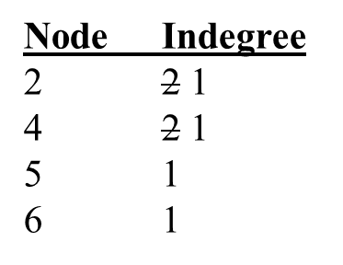
Topological sort
1
2
3
4
5
6
L: 1
F=1
R=2
 | 3
1 | 2 | 3 | 4 | 5 | 6 | 7 | 8 | 9 | 10
Dequeue 3
Dequeue 1

Slide 52
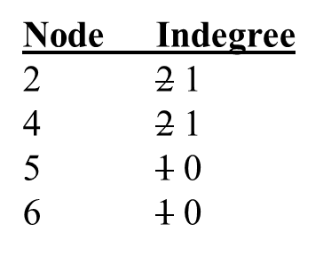
Topological sort
1
2
3
4
5
6
L: 1 3
F=0
R=0
1 | 2 | 3 | 4 | 5 | 6 | 7 | 8 | 9 | 10
Enqueue 5, 6
Dequeue 3

Slide 53
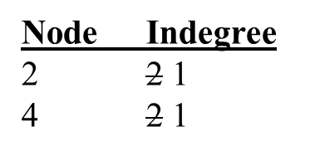
Topological sort
1
2
3
4
5
6
L: 1 3
F=1
R=2
5 | 6
1 | 2 | 3 | 4 | 5 | 6 | 7 | 8 | 9 | 10
Dequeue 5
Enqueue 5, 6

Slide 54
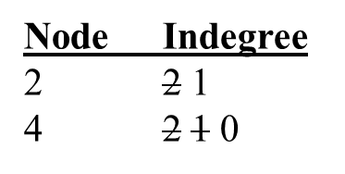
Topological sort
1
2
3
4
5
6
L: 1 3 5
F=2
R=2
 | 6
1 | 2 | 3 | 4 | 5 | 6 | 7 | 8 | 9 | 10
Enqueue 4
Dequeue 5

Slide 55
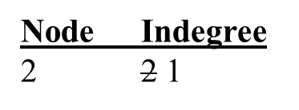
Topological sort
1
2
3
4
5
6
L: 1 3 5
F=2
R=3
 | 6 | 4
1 | 2 | 3 | 4 | 5 | 6 | 7 | 8 | 9 | 10
Dequeue 6
Enqueue 4

Slide 56
Topological sort
1
2
3
4
5
6
L: 1 3 5 6
F=3
R=3
 |  | 4
1 | 2 | 3 | 4 | 5 | 6 | 7 | 8 | 9 | 10
Dequeue 4
Dequeue 6

Slide 57
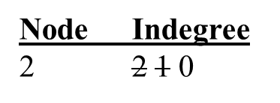
Topological sort
1
2
3
4
5
6
L: 1 3 5 6 4
F=0
R=0
1 | 2 | 3 | 4 | 5 | 6 | 7 | 8 | 9 | 10
Enqueue 2
Dequeue 4

Slide 58
Topological sort
1
2
3
Node Indegree
4
5
6
L: 1 3 5 6 4
F=1
R=1
2
1 | 2 | 3 | 4 | 5 | 6 | 7 | 8 | 9 | 10
Dequeue 2
Enqueue 2

Slide 59
Topological sort
1
2
3
Node Indegree
4
5
6
L: 1 3 5 6 4 2
F=0
R=0
1 | 2 | 3 | 4 | 5 | 6 | 7 | 8 | 9 | 10
Dequeue 2

Slide 60
Topological sort
1
3
5
6
2
4
L: 1 3 5 6 4 2
F=0
R=0
1 | 2 | 3 | 4 | 5 | 6 | 7 | 8 | 9 | 10

